Slide 1


Robotic Arm BCI
309
8 Credits
17/03/2021
Robotic Arm BCI
‹#›

Slide 2

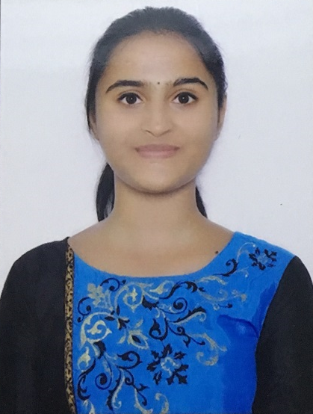

TEAM COMPOSITION
SL. NO | Name of the student | SRN | PHOTO
1 | Harshita R Vastrad | PES1201701717
2 | Shreya V Deexit | PES1201701648
3 | V Saisri | PES1201701763
Guide : Dr. B. Niranjana Krupa
Prof. Swetha G
17/03/2021
Robotic Arm BCI
‹#›

Slide 3
CONTENTS
SERIAL NO | CONTENT
1 | Problem Statement
2 | Objective
3 | Literature Survey
4 | Block Diagram
5 | Recap
6 | Objective for ISA2
7 | Constraints
8 | Work done
9 | Next Step
10 | Timeline
17/03/2021
Robotic Arm BCI
‹#›

Slide 4
PROBLEM STATEMENT
To use Brain computer interface(BCI) to interact between robot and human, without participation of human hand and assist the patient impaired by neurological conditions
The robotic arm will be able to pick up lightweight objects like medicines, water bottle etc. from one place as interpreted from the brain waves of the user and drop it to a predefined location
17/03/2021
Robotic Arm BCI
‹#›

Slide 5
OBJECTIVE
To use brain waves to control robotic arm movement:
Pre-processing the dataset,
classifying and sending the classified signal output to robot for arm movement.
Image processing for recognition of objects to pick and drop:
This process involves object detection.
The robot will be able to
detect objects,
Avoid obstacles,
pick and drop the detected object.
The outcome of this process is movement of the robotic arm without any motion or gesture in the patients.
17/03/2021
Robotic Arm BCI
‹#›

Slide 6
LITERATURE SURVEY
i)Pronadeep Bora; Vishwajit Nandi,”Low cost shadow function based articulated robotic arm”, 2015 International Conference on Energy, Power and Environment: Towards Sustainable Growth (ICEPE)
In choosing the material for the robotic arm frame and its shape, the following factors were taken under consideration:
Cost
Weight of robot
Ease of manufacturing the parts
Ease of assembly
Strength and durability of the parts
The basic requirements for efficient transmission of power of the robotic arm are:
Small size
Low weight and moment of inertia
High effective stiffness
Low energy losses
The servo motors are used for rotating the arm
17/03/2021
Robotic Arm BCI
‹#›
Notes:
https://ieeexplore.ieee.org/document/7510079

Slide 7
LITERATURE SURVEY
ii) Ana Riza F. Quiros,Alexander C. Abad,Elmer P. Dadios,”Object locator and collector robotic arm using artificial neural networks”, 2015 International Conference on Humanoid, Nanotechnology, Information Technology,Communication and Control, Environment and Management (HNICEM)
Model : ANN with 1 input layer,1 hidden layer and 1 output layer. The object's location will be fed as an input to the neural network. The neural network will process this data such that it will output a set of three angles at each joint angle of the robotic arm.
Performance : The performance is measured in terms of the mean squared error (MSE) for each epoch. MSE decreased as the number of epochs increased
Void : A camera focusing on an object of interest will capture an image and detect the mentioned object
17/03/2021
Robotic Arm BCI
‹#›
Notes:
https://ieeexplore.ieee.org/document/7393209

Slide 8
LITERATURE SURVEY
iii) Son Ngoc Truong Faculty of Electrical and Electronics Engineering HCMC University of Technology and Education,”A Low-cost Artificial Neural Network Model for Raspberry Pi”Engineering, Technology & Applied Science Research
Dataset: MNIST dataset for image recognition.
Method: A complementary binary array to represent the signed synaptic weights was used.
Model: 3×3 kernels in each convolutional layer, followed by a Max pooling layer. The fully-connected layer was composed of two hidden layers of 1024 hidden nodes. The output layer had 10 neurons. Then, this model was deployed on Raspberry Pi board.
Accuracy:Recognition rate of 89%
Void:High power consumption
17/03/2021
Robotic Arm BCI
‹#›
Notes:
https://etasr.com/index.php/ETASR/article/view/3357/pdf

Slide 9
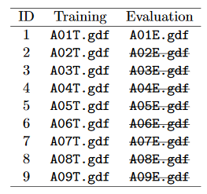
DATASET
BCI Competition 2008 – Graz data set A :
9 participants . 4 classes. Left hand,Right hand, Feet, Tongue.
22 EEG signals, 3 EOG signals(for eye movements)
Signals were sampled at 250Hz, and bandpass 0.5Hz and 100Hz,The sensitivity of the amplifier was set to 100μV. An additional 50 Hz notch filter was enabled to suppress line noise.
Files are in .gdf format
Files in the dataset:
23/12/2020
Robotic Arm BCI
‹#›

Slide 10
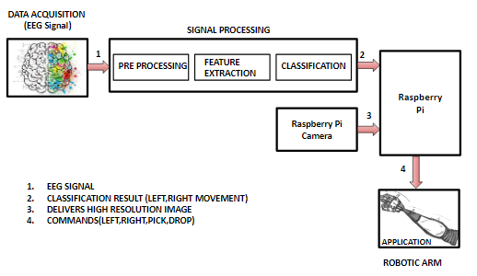
Block Diagram
17/03/2021
Robotic Arm BCI
‹#›

Slide 11
RECAP
Dataset - BCI Competition 2008 – Graz data set A
Pre-processing - event extraction, bandpass filtering, channel selection
Feature extraction - Wavelet packet decomposition
ANN architecture is used to classify the 4 classes
Model Summary:
4 layers
Input layer-124 neurons, dropout:0.5, Activation function: Relu.
2 hidden layers-124 neurons, dropout:0.5, Activation function: Relu, L2 regularisation
Output layer-4 neurons, Activation function: Softmax
Optimizer - Rmsprop
Accuracy - 0.710345
Assembling hardware components
Detecting blue colored objects
17/03/2021
Robotic Arm BCI
‹#›

Slide 12
MODEL
Class 1
Class 2
Class 3
Class 4
Input Layer
(124 neurons)
Hidden Layers
(124 neurons)
Output Layer
(4 neurons)
17/03/2021
Robotic Arm BCI
‹#›

Slide 13
OBJECTIVE FOR ISA2
Coloured object detection
detection of Red, Green, Orange and Blue colored objects
Robot movement to go in direction of colored object
Robot moves forward
Robot moves backward
17/03/2021
Robotic Arm BCI
‹#›

Slide 14
CONSTRAINTS
Colored objects are considered to be Lightweight objects
Input given to robotic arm and object color that has to be picked
1 - Left - Orange
2 - Right - Red
3 - Front - Blue
4 - Back - Green
Based on the input Robotic arm rotates and moves in that direction,
detecting the colored object and avoiding the obstacles encountered in the path
17/03/2021
Robotic Arm BCI
‹#›

Slide 15
INSTALLING MODULES
Cmake
Libjpeg-dev,Libpng-dev,Libtiff-dev
Libavcodec-dev,Libavformat-dev,Libswscale-dev,Libv4l-dev
Libxvidcore-dev,Libx264-dev
Libgtk-3-dev
Libatlas-base-dev gfortran
python3-dev
OpenCV
17/03/2021
Robotic Arm BCI
‹#›

Slide 16
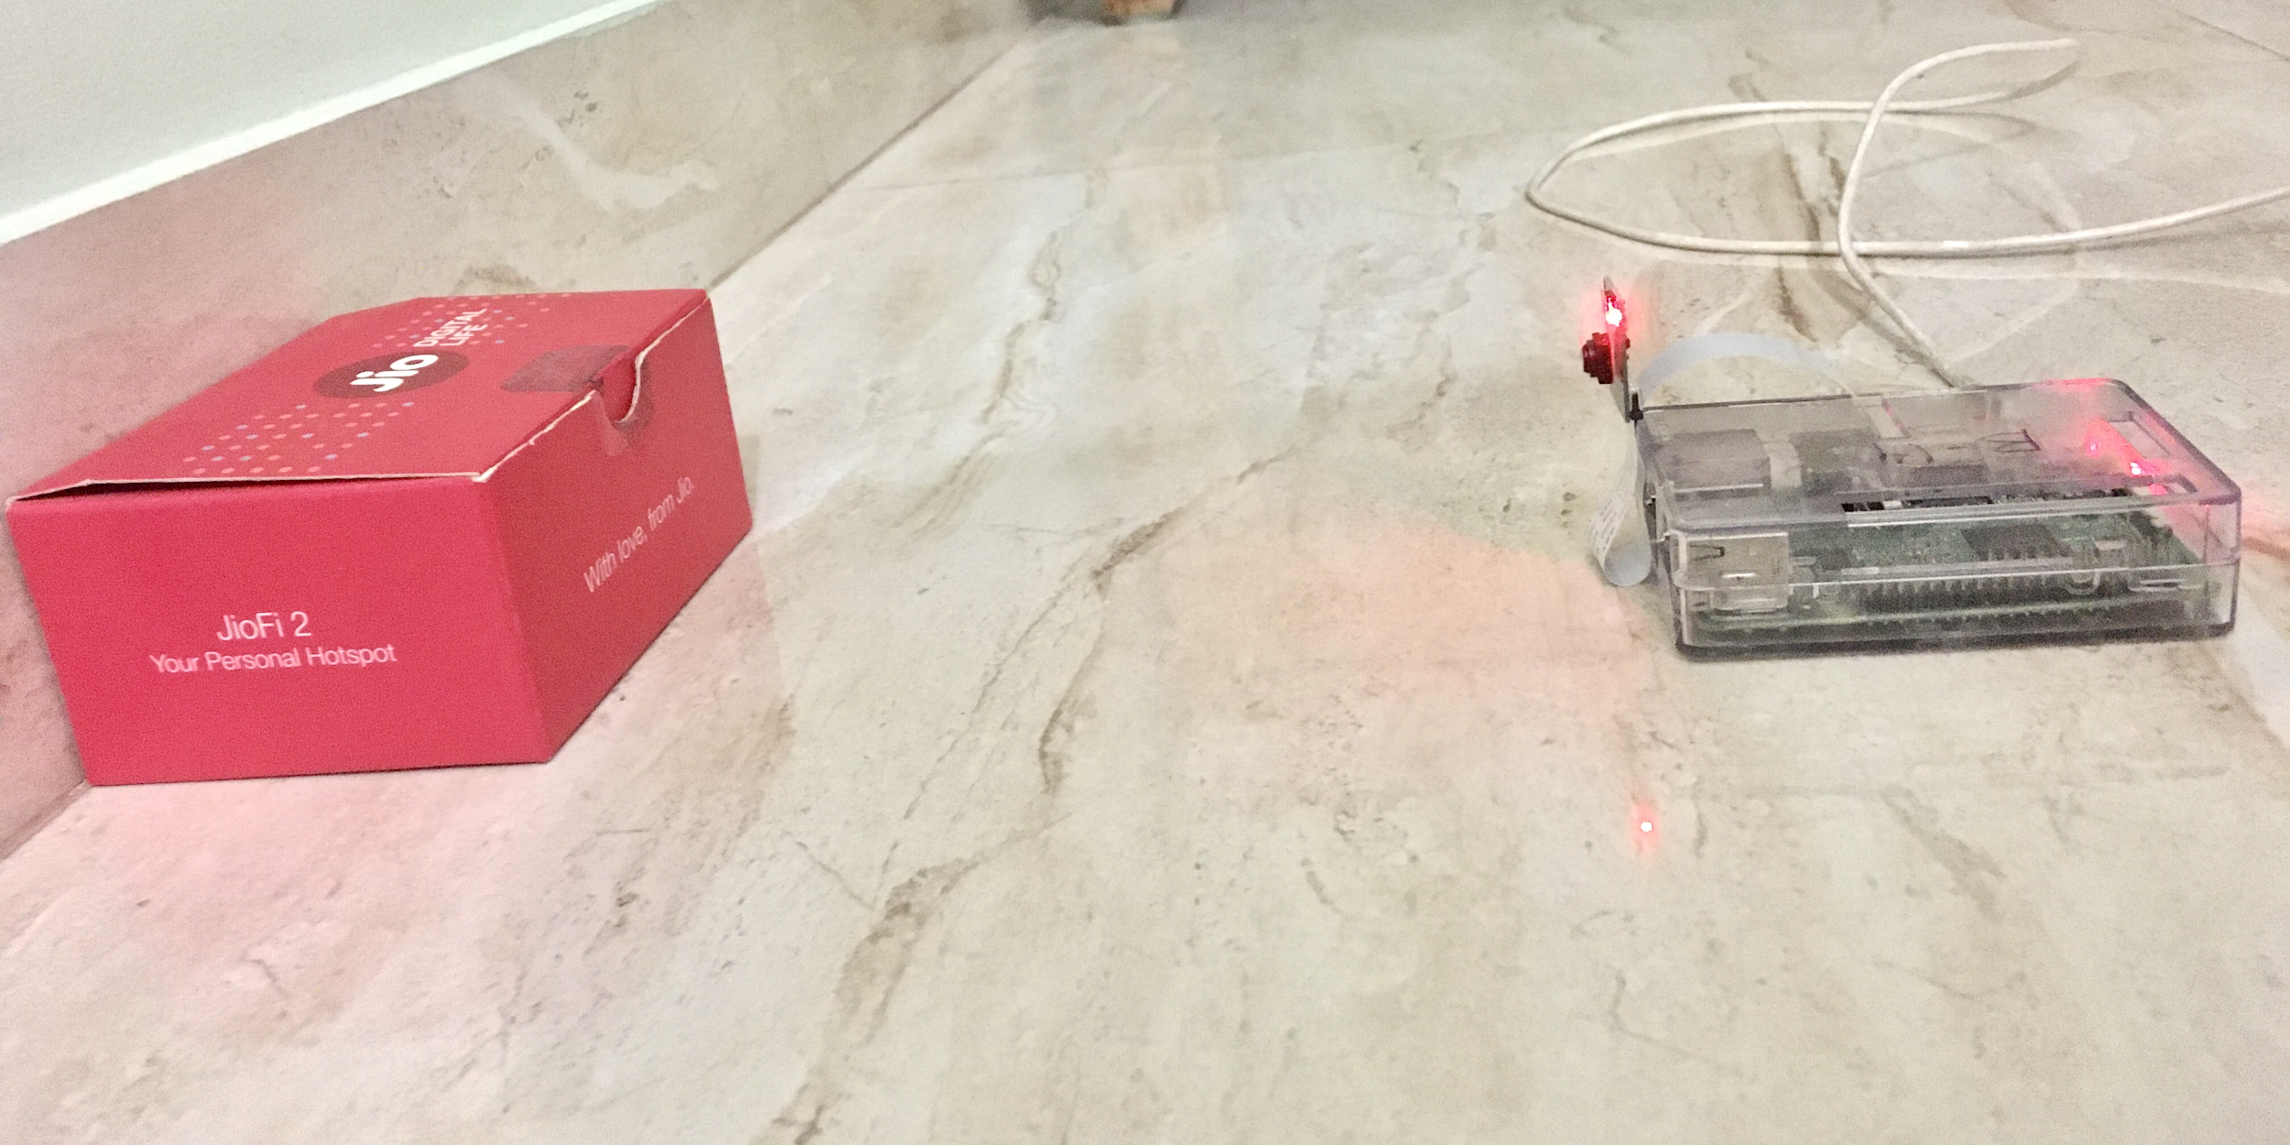
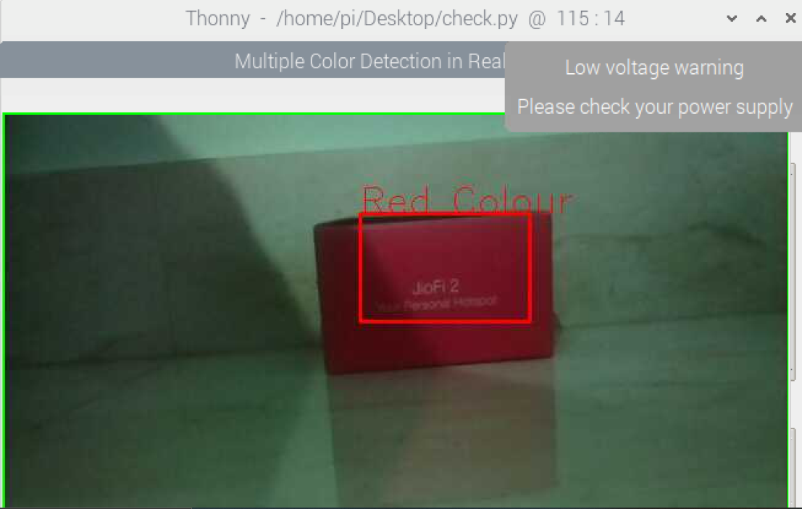
OBJECT COLOR DETECTION
Setup for colour detection
Image showing the output of detected red coloured object
17/03/2021
Robotic Arm BCI
‹#›

Slide 17
WORKFLOW
Step 1 : Input: Capture video through raspberry pi camera. Step 2 : Read the video stream in image frames. Step 3 : Convert the imageFrame in BGR(RGB color space represented with integer values from 0 to 255) to HSV(hue-saturation-value) color space (three matrices in the range of 0-179, 0-255 and 0-255 respectively.) Step 4 : Define the range of each color and create the corresponding mask. Step 5 : Dilation, to remove noises from the images. Step 6 : bitwise_and between the image frame and mask is performed to specifically detect that particular color and discard others. Step 7 : Create contour for the individual colors to display the detected colored region distinguishably. Step 8 : Output: Detection of the colors in real-time.
17/03/2021
Robotic Arm BCI
‹#›

Slide 18
WORKFLOW
Get image frames from video
Convert BGR color space to HSV color space
Define the range and create mask
Capture video through pi camera
Create contour to track color
Bitwise and between image frame and mask
Color detection
Dilation
17/03/2021
Robotic Arm BCI
‹#›

Slide 19

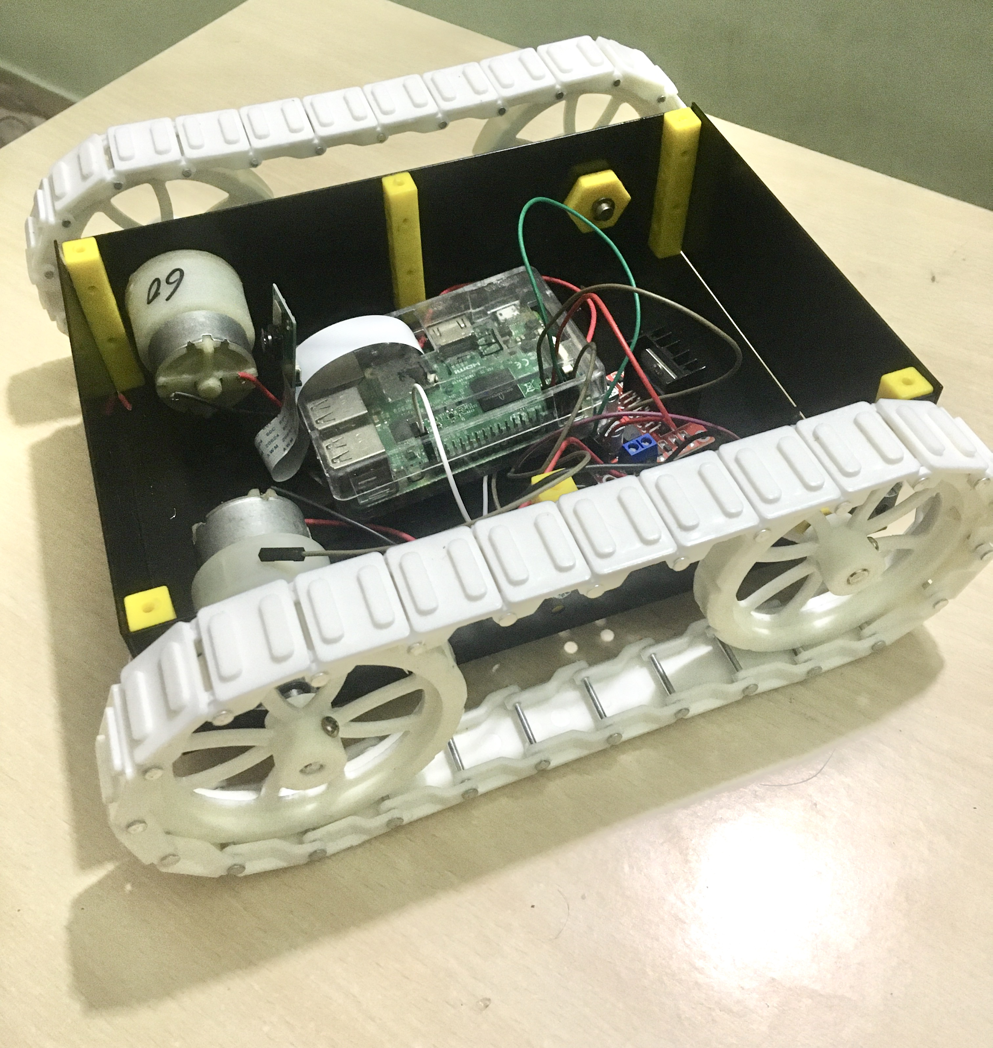




MOTOR MOVEMENTS
17/03/2021
Robotic Arm BCI
‹#›

Slide 20
NEXT STEP
Robot movement in left and right direction
Arm movement for picking and placing
Integration of object colour detection and pick and place
Integrating the model with raspberry pi
17/03/2021
Robotic Arm BCI
‹#›

Slide 21
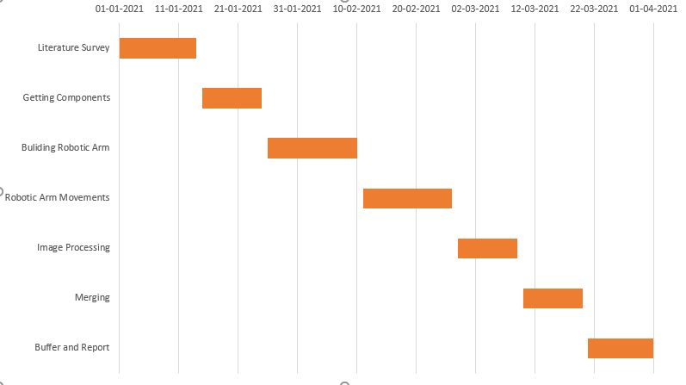
TIMELINE
17/03/2021
Robotic Arm BCI
‹#›

Slide 22
REFERENCES
Pronadeep Bora; Vishwajit Nandi,”Low cost shadow function based articulated robotic arm”, 2015 International Conference on Energy, Power and Environment: Towards Sustainable Growth (ICEPE)
Ana Riza F. Quiros,Alexander C. Abad,Elmer P. Dadios,”Object locator and collector robotic arm using artificial neural networks”, 2015 International Conference on Humanoid, Nanotechnology, Information Technology,Communication and Control, Environment and Management (HNICEM)
Son Ngoc Truong Faculty of Electrical and Electronics Engineering HCMC University of Technology and Education,”A Low-cost Artificial Neural Network Model for Raspberry Pi”Engineering, Technology & Applied Science Research
Running a Convolutional Neural Network on Raspberry PI https://medium.com/swlh/running-a-convolutional-neural-network-on-raspberry-pi-4fc5bd80aa4d
17/03/2021
Robotic Arm BCI
‹#›

Slide 23
THANK YOU...
17/03/2021
Robotic Arm BCI
‹#›

